Slide 1

Early Career Teachers · Session 5
Working in Partnership
Notes:
SUGGESTED TIME: 1 min · 2:15 - 2:16
PURPOSE
Open the partnership session and connect it to the design work.
WHAT TO DO
1. Name the shift from what educators can design in the classroom to how home and school can understand and act together.
2. Pick up the asking list participants wrote in Session 4 (Day-one setup sheet, section 4, and the Commit on p. 21): this session is about the people on that list.
3. Acknowledge that a new teacher is often joining relationships and school processes that are already in place, and is not expected to manage every conversation or decision alone.
4. Keep the student at the centre of the conversation.
5. Acknowledge that participants may bring both productive and difficult partnership experiences, including as family members themselves.
6. Remind the room that sharing is voluntary and examples stay anonymised (initials or roles only).
KEY MESSAGES
• Partnership is part of understanding and support, not an additional task after decisions are made.
• The student, family and school may each hold different parts of the picture.
• Knowing when and from whom to seek support is part of preparing well.
THREAD
Picks up the asking list from Session 4 (Day-one setup sheet, section 4; Participant Guide p. 21 - Commit: "My asking list goes to").

Slide 2
Working in partnership
Family
School staff
What is the goal of these intersecting partnerships?
Every partner brings different knowledge and a different relationship with the student.
The student is at the centre of every partnership.
Student
Paraprofessionals
Notes:
SUGGESTED TIME: 3 min · 2:16 - 2:19 · Participant Guide p.22 - Session 5 summary
PURPOSE
Show where the partnerships around a student intersect, with the student at the centre of every one.
WHAT TO DO
1. Introduce the Venn: family, school staff and paraprofessionals, with the student at the centre.
2. Explain that every partner brings unique knowledge, expertise and perspectives, and a different relationship with the student and with each other.
3. Ask the group: What is the goal of these intersecting partnerships? Take 2-3 responses.
4. Steer the discussion so the point is made that the student is at the centre of all partnerships.
5. Link back where relevant: sensory and thinking experience (Session 2), Autistic experience at school (Session 3), and the day-one setup and continuum of support (Session 4).
6. Ask who is missing from the picture and how the student's communication can be included.
7. Point participants to Where partnerships converge in the Participant Guide (p. 22).
YOU MIGHT SAY
What is the goal of these intersecting partnerships?
KEY MESSAGES
• Positive partnership keeps the student at the centre.
• No single person holds the complete picture.
• Every partner brings different knowledge and a different relationship with the student.
KEEP IN MIND
• Use the elements as discussion prompts rather than a complete definition.
BACKGROUND
With session time limited, this slide is a chance to see where all the partnerships converge and what is needed for success across all of them.
THREAD
Draws on sensory and thinking experience (Session 2), Autistic experience at school (Session 3) and the Session 4 day-one setup and continuum of support.

Slide 3

Building a home-school partnership
Parents and families are the first and continuing educators of their children
Learning is lifelong and occurs in multiple settings
Partnerships, schools and school communities flourish when the diversity and strengths of families are valued and leveraged
Community engagement expands responsibility and resources
Partnerships grow from mutual trust, respect and responsibility
Partnerships need committed, collaborative and creative leadership
Family-School Partnerships Framework, Department of Education, 2020
Notes:
SUGGESTED TIME: 2 min · 2:19 - 2:21
PURPOSE
Make positive partnership concrete in educator practice using the Family-School Partnerships Framework principles.
WHAT TO DO
1. Walk through the six Framework principles briefly.
2. Position family knowledge and school knowledge as different, useful perspectives.
3. Name what makes partnership visible in practice: a shared purpose, respectful listening, student voice and communication, clear accessible information, and agreed next steps, responsibilities and follow-up.
KEY MESSAGES
• The student, family and school may each see different parts of experience. Partnership helps these perspectives inform understanding, design, action and review from the beginning.
• Listening, clarity and shared next steps can be observed in practice.
KEEP IN MIND
• Avoid implying that agreement is required before listening or respect are possible.
RESOURCES
Family-School Partnerships Framework - Department of Education, Australian Government - https://www.education.gov.au/supporting-family-school-community-partnerships-learning/family-school-partnerships/family-school-partnerships-framework

Slide 4
What is effective collaboration?
Shared goals
Seeing other perspectives
Shared values
Invite curiosity: How could we work together for better learning outcomes?
Mutual trust and respect
Centring student voice
Consult on decision-making
Assume good intent
Notes:
SUGGESTED TIME: 3 min · 2:21 - 2:24
PURPOSE
Name the collaboration principles that strong partnerships share, whoever is at the table.
WHAT TO DO
1. Introduce the importance of collaboration: for Autistic students there are multiple collaboration points across multiple partnerships.
2. Explain that the key collaboration skills are the same across all groups, and are vital for strong partnerships.
3. Ask the group: What are some of the key principles for effective collaboration to occur?
4. Build the discussion to cover: shared goals, shared values, mutual trust and respect, consulting on decision-making, seeing other perspectives, inviting curiosity, centring student voice, assuming good intent.
5. If the cards are set to reveal on click, reveal them once the room has contributed.
YOU MIGHT SAY
What are some of the key principles for effective collaboration to occur?
How could we work together for better learning outcomes?
KEY MESSAGES
• The collaboration skills needed are the same across every partnership around the student.
BACKGROUND
This slide was added by the team because it works well with all parties and helps shift perspectives. Early career teachers can use these principles from their first contact with a family, before they know the school's processes well.

Slide 5
Families near the start of the journey
Start with where the family is now.
Around diagnosis
Some families are new to autism, new terms and new services.
First meetings
Meeting a new teacher can bring back earlier experiences with school.
Transition points
Starting school, a new year or a new school can be a hard time.
What helps
A clear purpose, plain language, time for questions and a next step everyone understands.
You don't need every answer. Curiosity and clear information help more.
Notes:
SUGGESTED TIME: 3 min · 2:24 - 2:27 · Participant Guide p.22 - Session 5 summary (Families near the start of the journey)
PURPOSE
Prepare participants to meet families at different points, including diagnosis years, first meetings and transitions, without assuming a single journey, language or pace.
WHAT TO DO
1. Read the heading line: start with where the family is now.
2. Walk through the four cards: diagnosis years, first meetings, transition points and what helps.
3. Ask the group: What might a family be carrying into a first meeting with a new teacher? Take 2-3 responses.
4. Give a primary and a secondary example if it helps: a family whose child starts school soon after a diagnosis; a family whose child is moving to a new secondary school.
5. Note that families may bring different histories, questions, priorities, terms and capacity to a conversation.
6. Point to the last line: you don't need every answer. Curiosity and clear information help more.
YOU MIGHT SAY
What might a family be carrying into a first meeting with a new teacher?
KEY MESSAGES
• Start with where the family is now.
• Families may bring different histories, questions, priorities and capacity to a conversation.
• A clear purpose, plain language, time for questions and a next step everyone understands help at any point in the journey.
• You don't need every answer. Curiosity and clear information help more.
KEEP IN MIND
• Do not assume every family is newly diagnosed, uses the same terms or wants the same next step.
• Keep the focus on preparation, listening and clarity rather than identifiable family stories.
BACKGROUND
A first meeting with a new teacher, or a move to a new year or school, can bring back earlier experiences with school, both good and difficult. Some families are still learning new terms and services; others have years of experience and may know more about their child's supports than the school does. Early career teachers can be prepared and clear without assuming what the family has been through.
THREAD
The scenarios in The first two minutes (slide 10) are set at these points: a first meeting of the year, a recent diagnosis and a new teacher.

Slide 6

Power dynamics
Power can sit in:
Student
Socio-economic status
Historical / cultural experiences of education
Speaking English vs speaking a language other than English
Pedagogy / understanding of school systems and curriculum
Home
School
Perception of the importance / experience of school
Notes:
SUGGESTED TIME: 2 min · 2:27 - 2:29
PURPOSE
Help participants notice how agendas, language, authority and decision-making shape consultation.
WHAT TO DO
1. Introduce the seesaw: school, home and the student.
2. Name where power can sit: socio-economic status, historical and cultural experiences of education, speaking English or another language, understanding of school systems and curriculum, and perceptions of the importance of school.
3. Ask the power questions below to examine practice, not to blame individual participants.
4. Invite participants to identify where school language, timing or process may create a barrier.
5. Note that an early career teacher may notice a barrier they cannot change alone, and can raise it with a mentor or leader.
YOU MIGHT SAY
Who sets the agenda?
Whose knowledge is heard?
Who can make decisions?
Are roles and limits clear?
Is the student included in a way that works for them?
What could the school change about the process?
KEY MESSAGES
• Power is present in meeting structures, language and decision pathways.
• Early career teachers can notice barriers and seek support to change the process.
KEEP IN MIND
• Avoid describing a family as difficult, disengaged or unrealistic without examining the context and process.

Slide 7
Power dynamics activity
On Post-it notes:
1
Write an example of an imbalance in power dynamics from a home perspective.
2
Write an example of an imbalance in power dynamics from a school perspective.
3
Write how you could address these imbalances.
Share at your table, or add your notes to the wall under Home, School and Solutions.
6 minutes
Notes:
SUGGESTED TIME: 6 min · 2:29 - 2:35 · Participant Guide p.23 - Power dynamics
PURPOSE
Prompt educators to reflect on perceived and real power imbalances in the home-school relationship.
WHAT TO DO
1. Make sure every participant has Post-it notes and a pen.
2. Direct participants to the three instructions on the slide.
3. Choose a sharing option that suits the room (see steps).
4. Participants with little experience of family meetings can draw on placements, relief days or their own experience as a family member.
5. Support tables to look for solutions rather than place blame.
6. Take feedback from a few participants at the end.
KEY MESSAGES
• Power can be structural, historical, cultural, conscious and unconscious.
• Status can be perceived as an imbalanced power dynamic, regardless of intent.
ACTIVITY: Post-it note reflection · table groups · 6 minutes
Prompt: Where do power imbalances sit in the home-school relationship, and how could you address them?
1. On one Post-it, write an example of an imbalance in power dynamics from a home perspective.
2. On a second, write an example from a school perspective.
3. On a third, write how you could address these imbalances.
4. Option 1: share Post-it notes with your table.
5. Option 2 (movement break): take your Post-it notes to another person in the room to share.
6. Option 3: place Post-it notes on butcher's paper on the wall under Home, School and Solutions.
Bring the room back:
• Who sets the agenda?
• Whose knowledge is heard?
• Who can make decisions?
• What could the school change about the process, and who could help you raise that change?
Close: Ask participants to keep one process change for their family-conversation plan.
KEEP IN MIND
• This may be challenging for some participants, who may have found themselves in positions of power or lack of power at different times in their career. Guide individuals to seek solutions and not place blame.
BACKGROUND
Educators are immersed in the culture of education, including a shared understanding of acronyms (e.g. NAPLAN, NCCD, IEP) which families may not be able to access as easily. Some people will purposely and naturally endow teachers with higher status, which can be a cultural or personal attitude. External providers and professionals can also affect the power dynamic between those working with and supporting Autistic students.
THREAD
The process change chosen here carries into the bridge reflection (slide 19) and the Session 6 conversation plan.

Slide 8

Student voice
What decisions were made, and who made them?
What impact did those decisions have on Adon?
Notes:
SUGGESTED TIME: 5 min · 2:35 - 2:40 · Participant Guide p.23 - Student voice
PURPOSE
Show what happens when a student is not listened to or consulted.
WHAT TO DO
1. Introduce the video as an example of a student who is not listened to or consulted.
2. Ask participants, while watching, to pay attention to what decisions were made and who made them.
3. Play the video.
4. Ask the group: What impact did those decisions have on Adon?
5. Connect to the students participants have in mind: how are their preferences asked and heard? This is the third column on p. 23.
YOU MIGHT SAY
While watching, pay attention to what decisions were made and who made them.
What impact did those decisions have on Adon?
KEY MESSAGES
• Students should have a say in decisions about them, at their level and in the way they communicate.
• Even young children can show preferences: choices offered visually, reactions observed and honoured.
• Ask students in a way that works for them: what helps? what's hard? what should teachers know?
• Record their answers in their own words, so the student's view is part of the record.
• This is an early step in building self-advocacy.

Slide 9
Partnership activity
For each partner: what do they bring, and what challenges might they face?
Student
Parents and carers
Teachers
Paraprofessionals
Brings
Brings
Brings
Brings
Challenges
Challenges
Challenges
Challenges
8 minutes
Then compare: what do all four have in common?
Notes:
SUGGESTED TIME: 8 min · 2:40 - 2:48 · Participant Guide p.24 - Partnership activity
PURPOSE
Compare what each partner brings and the challenges they may face, and find what they share.
WHAT TO DO
1. Make sure each table has the Partnership activity grid in the Participant Guide (p. 24).
2. Ask table groups to record what each partner brings and what challenges they might face: student, parents and carers, teachers, paraprofessionals.
3. Ask tables to compare: what do all four have in common? Remind them that paraprofessionals and other support staff often know a student well.
4. Take thoughts on similarities and differences, list the commonalities, and ask what would make the partnership more successful.
KEY MESSAGES
• Understanding the challenges and strengths of each partner can help build trust and confidence in the relationship.
• There are similarities and differences between what each partner brings to the partnership.
• Everyone has the student at the centre and student voice is included.
• At the heart of all interactions there should be an assumption of good intent regarding the outcomes for the student.
ACTIVITY: Table group partnership grid · table groups · 8 minutes
Prompt: For each partner: what do they bring, and what challenges might they face?
1. Work through the four partners: student, parents and carers, teachers, paraprofessionals.
2. For each, note what they bring and what challenges they might face.
3. Compare: what do all four have in common?
Bring the room back:
• What are the similarities and differences across the four partners?
• What would make the partnership more successful?
Close: List the commonalities the room names and link them to the collaboration principles on slide 4.

Slide 10

The first two minutes
Pairs: one of you is the teacher, the other plays a parent or a student.
Use a scenario from your Participant Guide. For two minutes, only ask and listen back. No solving yet. Then swap.
What helps:
Be prepared for meetings
Share information
Ask questions
Seek clarification
Assume the best
6 minutes
Notes:
SUGGESTED TIME: 6 min · 2:48 - 2:54 · Participant Guide p.24 - The first two minutes
PURPOSE
Practise opening a conversation by asking and listening back before solving.
WHAT TO DO
1. Put participants in pairs. One is the teacher; the other plays a parent or a student.
2. Direct pairs to the three scenarios in the Participant Guide (p. 24). Each pair chooses one.
3. Explain the rule: for two minutes the teacher only asks and listens back. No solving yet.
4. Start a visible two-minute timer. Call time, then ask pairs to swap roles and choose a second scenario.
5. Offer writing instead of role-play: anyone can script the two minutes on paper instead.
6. Use the last 2 minutes for the debrief. Take 2-3 responses.
YOU MIGHT SAY
For two minutes, only ask and listen back. No solving yet.
KEY MESSAGES
• What helps: be prepared for meetings, share information, ask questions, seek clarification and assume the best.
• Asking first often brings out information that solving first would miss.
• Listening back shows the family or student they have been heard.
ACTIVITY: Paired practice (role-play or written) · pairs · 6 minutes
Prompt: For two minutes, only ask and listen back. No solving yet.
1. Decide who is the teacher and who plays the parent or student.
2. Choose a scenario from p. 24: (1) a parent at the first meeting of the year: "Last year's teacher really understood him. I'm worried about starting again." (2) a parent of a Year 2 student: "We only got the diagnosis in the holidays. I don't know what to ask for." (3) a Year 8 student meeting a new teacher: "I don't want to be treated differently."
3. Two minutes: the teacher only asks questions and listens back.
4. Swap roles and use a second scenario.
5. If you prefer, write the two minutes as a script instead of role-playing it.
Bring the room back:
• What did asking first bring out?
• What made it hard not to jump to solutions?
Close: Ask everyone to write one question they will use to open a conversation in the third column on p. 24. They will use it in the bridge (slide 19) and in Session 6.
KEEP IN MIND
• Keep it low-stakes. Some participants will find role-play uncomfortable; the written option is equally valid.
• Some participants may be parents or family members of Autistic children, and a scenario may feel close to home. They can choose another scenario, write, or listen.
• Keep the parent and student roles respectful; avoid playing them as difficult.
BACKGROUND
Two minutes of only asking can be hard for teachers, who are used to solving problems. The scenarios are set at points covered on slide 5: a first meeting of the year, a recent diagnosis, and a student meeting a new teacher. The What helps list on the slide gives participants moves they can use in any of them.
THREAD
Builds on Families near the start of the journey (slide 5). The opening question carries into the bridge (slide 19) and the opening sentence in the Session 6 conversation plan (p. 28).

Slide 11
Meeting families where they are
Listen before solving.
Ask about communication preferences and priorities
Make room for questions and uncertainty
Explain roles, options and next steps plainly
Check what is workable for the family now
Avoid judging a family's pace, response or choices
Environment-first thinking applies to meetings too: what could the school change about the process?
Notes:
SUGGESTED TIME: 2 min · 2:54 - 2:56
PURPOSE
Emphasise listening before solving, and making room for questions, uncertainty and different priorities.
WHAT TO DO
1. Read the six practices briefly.
2. Emphasise listening before solving and making room for questions, uncertainty and different priorities.
3. Invite participants to identify where school language, timing or process may create a barrier, and who in their school they could raise it with.
4. Make the key point: environment-first thinking applies to meetings too.
YOU MIGHT SAY
What could the school change about the process?
KEY MESSAGES
• Power is present in meeting structures, language and decision pathways.
• Meeting families where they are begins with listening and clarity.
• Environment-first thinking also applies to consultation processes.
KEEP IN MIND
• Avoid judging a family's pace, response or choices.
• Avoid describing a family as difficult, disengaged or unrealistic without examining the context and process.

Slide 12
Consultation literacy
Useful consultation includes:
A clear, shared purpose
Open questions
More than one way to contribute
Respect for student and family knowledge
Accurate recording of what was heard
An agreed action, responsibility and follow-up
Ask, listen, and follow up.
Notes:
SUGGESTED TIME: 2 min · 2:56 - 2:58 · Participant Guide p.25 - Consultation checklist
PURPOSE
Introduce consultation literacy: asking, listening and following up.
WHAT TO DO
1. Walk through what useful consultation includes.
2. Frame the list as a check participants can use before and after a meeting.
3. Make the point: ask, listen, and follow up.
KEY MESSAGES
• Ask, listen, and follow up.
• Tools should support consultation rather than replace listening and student voice.

Slide 13
Consulting students and families
With students
With families
Offer communication choices
Meeting preparation
Start with students’ strengths and interests
Listen to families and value their insights
Simple choices
Processing time
Use clear, simple language
Respect different perspectives / experiences
Sensory-friendly spaces
Behaviour as communication
Focus on needs, goals and participation
Use real examples from school
Strengths and interests
Support - don’t speak for
Check for shared understanding
Agree on next steps
Clear, accessible questions
Keep communication open and ongoing
Notes:
SUGGESTED TIME: 2 min · 2:58 - 3:00
PURPOSE
Give practical ways to consult students and families so every voice can be heard.
WHAT TO DO
1. Take the two columns in turn: with students, then with families.
2. With students: presume competence, provide communication supports, offer choices, allow time, and act on what students tell us.
3. With families: start with the student's strengths, interests and what works well, and listen to families' knowledge of their child without making assumptions.
4. Keep this brief. Ask participants to pick one practice from each column to try with the students they have in mind.
KEY MESSAGES
• Listen, adapt, give choices, and make it easy for every student to have a voice.
• Ensure trusted supporters assist communication without replacing the student's voice.
• Use plain language and explain educational terms clearly.
• Focus on the student's needs and goals, not just their diagnosis.
• Recognise that some parents will be neurodivergent themselves.
BACKGROUND
Student consultation: provide multiple communication options (AAC, visuals, writing, drawing, video, symbols); prepare students in advance with questions, agendas and meeting information; use supported decision-making with simple choices and extra processing time; create sensory-friendly environments; recognise that behaviour is communication and can indicate preferences; build on strengths, interests and preferences; use accessible, strengths-based questions. Family consultation: be respectful of different cultures, experiences and family perspectives; use real examples from school to discuss supports and adjustments; check everyone has the same understanding; agree clear next steps and how progress will be reviewed; keep communication open and ongoing.
THREAD
Picks up the continuum of support and NCCD from Session 4.

Slide 14
Asking is part of the job
Early in your career, asking is a strength.
Ask families
“What works at home?” in the first weeks shows care and professionalism.
Ask the student
They are often the quickest way to understand what helps.
Ask colleagues
Support staff who have known a student for years often know the most.
It is fine to say so
Saying you are still finding out is better than guessing.
Teachers who ask early tend to keep asking. It is a good habit to start.
Notes:
SUGGESTED TIME: 3 min · 3:00 - 3:03 · Participant Guide p.22 - Session 5 summary (Asking is part of the job)
PURPOSE
Show early career teachers that asking families, students and colleagues is good practice, not a sign of inexperience.
WHAT TO DO
1. Read the heading line: early in your career, asking is a strength.
2. Walk through the four cards: ask families, ask the student, ask colleagues, and it is fine to say so.
3. Give weight to support staff. Teacher aides, learning support staff and others who have known a student for years often know the most about what helps.
4. Relief and casual teachers can ask the classroom teacher, the support staff in the room and the student.
5. Link back to the asking list from Session 4: the people on it are a good place to start.
6. Ask participants: Who is one person you could ask about a student in the next week? Give a moment to note it.
YOU MIGHT SAY
Who is one person you could ask about a student in the next week?
KEY MESSAGES
• Asking families "What works at home?" in the first weeks shows care and professionalism.
• The student is often the quickest way to understand what helps.
• Support staff who have known a student for years often know the most.
• Saying you are still finding out is better than guessing.
KEEP IN MIND
• Present asking as normal professional practice, not another task on the list.
• Share information about students through your school's usual processes.
BACKGROUND
New teachers can feel they are expected to already know. Guessing, or staying quiet to avoid looking unsure, can mean a student goes longer without the support that helps. Asking early builds the relationships participants will rely on, and it is a habit that tends to continue.
THREAD
Builds on the Session 4 asking list (Day-one setup sheet, section 4) and The first two minutes (slide 10).

Slide 15
When student capacity runs out
Discuss capacity without blame. Home and school may observe different parts of the student's experience.
Meltdown
Shutdown
School Can’t
Focus on safety, what preceded the situation, what supports recovery and what can change in the environment, task or response.
Notes:
SUGGESTED TIME: 3 min · 3:03 - 3:06
PURPOSE
Introduce meltdown, shutdown and School Can't within partnership discussion, without blame.
WHAT TO DO
1. Introduce the three terms without presenting them as wilful behaviour.
2. Connect discussion to accumulated demands, what may not be visible, and what home and school can learn from each other.
3. Ask what information, listening and environmental change would help the team respond more safely and usefully.
4. Point to the focus line: safety, what preceded the situation, what supports recovery and what can change in the environment, task or response.
5. Remind participants to follow local wellbeing, safety and support processes and involve the right school staff. A new teacher does not solve this alone.
KEY MESSAGES
• Capacity should be discussed without blame.
• Home and school may observe different parts of the student's experience.
• Use non-blaming language and the workshop safety guidance.
KEEP IN MIND
• Do not frame meltdown, shutdown or School Can't as wilful misbehaviour or a failure of parenting.
• Do not offer clinical, diagnostic, legal or crisis guidance beyond the material.
THREAD
Builds on capacity and accumulated demands from Sessions 2 and 3.

Slide 16
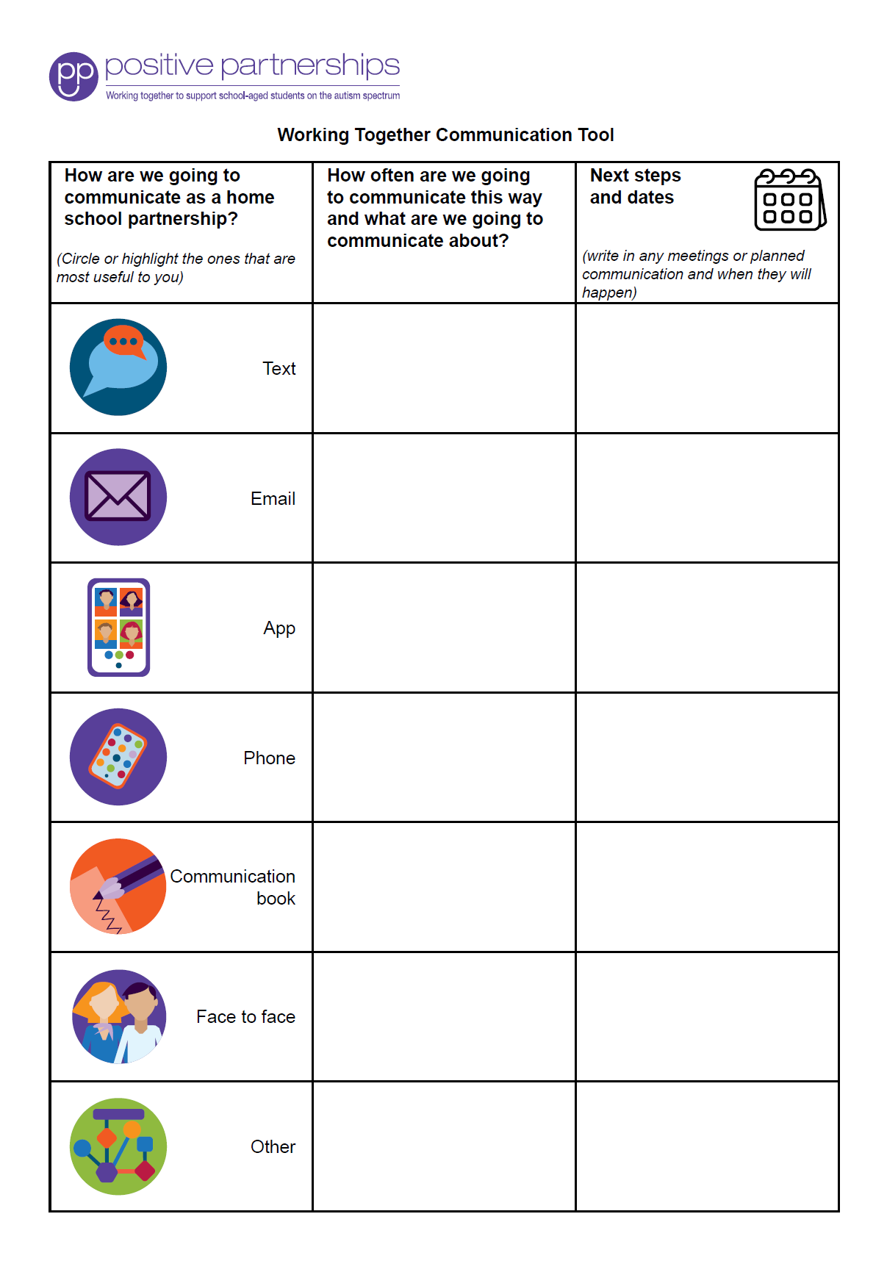
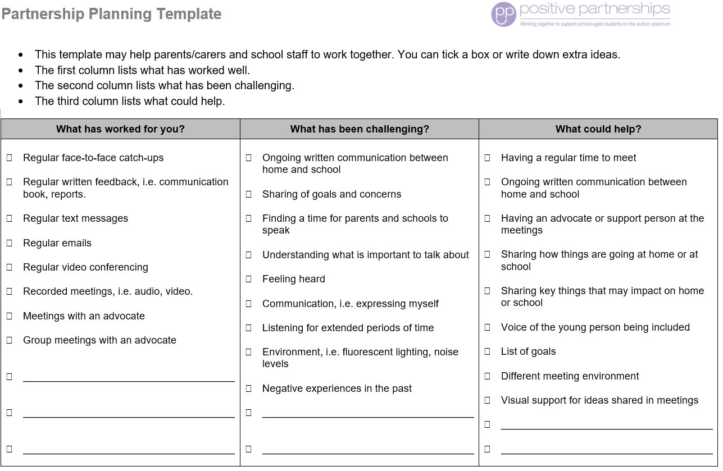
Partnership tools
Notes:
SUGGESTED TIME: 1 min · 3:06 - 3:07
PURPOSE
Demonstrate the Partnership tools and explain how they are used.
WHAT TO DO
1. Show the Partnership tools and explain briefly how each is used.
2. Frame the tools as supports for consultation, not replacements for listening.
3. Suggest participants ask their mentor or leader which tools their school already uses.
KEY MESSAGES
• Tools should support consultation rather than replace listening and student voice.

Slide 17
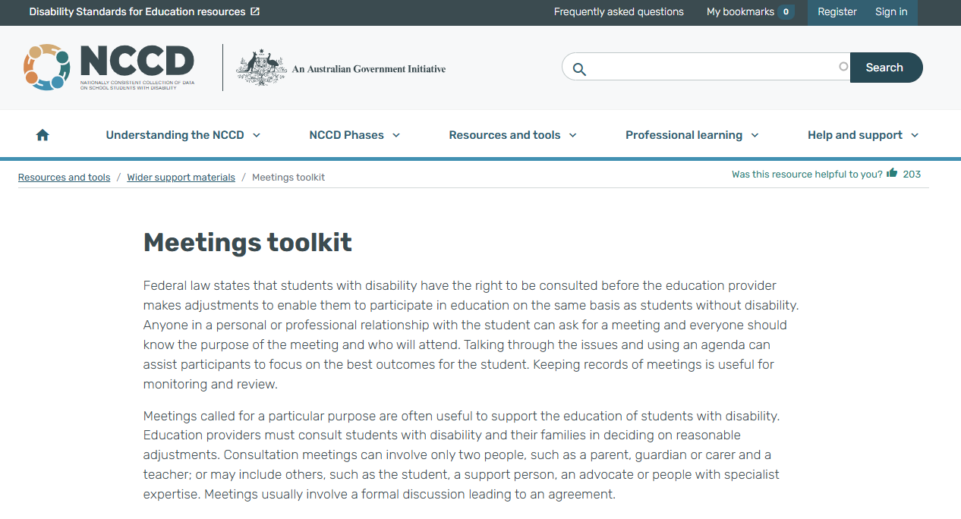
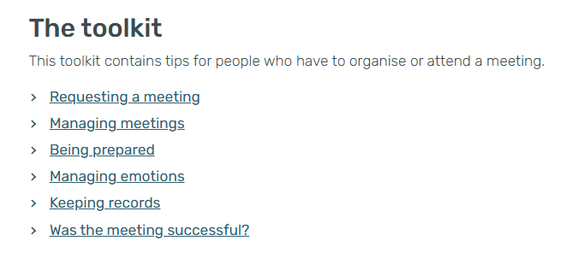
NCCD Meetings Tool Kit
Use the Tool Kit to make the meeting purpose, consultation process, possible adjustments, evidence and next steps clear. Follow the processes used in your school or system, and explain responsibilities and follow-up.
Notes:
SUGGESTED TIME: 2 min · 3:07 - 3:09
PURPOSE
Introduce the NCCD Meetings Tool Kit and direct participants to official NCCD information.
WHAT TO DO
1. Explain how the Tool Kit makes the meeting purpose, consultation process, possible adjustments, evidence and next steps clear.
2. Remind participants to follow the processes used in their school or system.
3. Note that early career teachers may not lead these meetings, and should know their role, who makes decisions and who can guide their questions.
4. Emphasise explaining responsibilities and follow-up to families.
5. Direct participants to official NCCD information.
KEY MESSAGES
• NCCD information must be current and official.

Slide 18
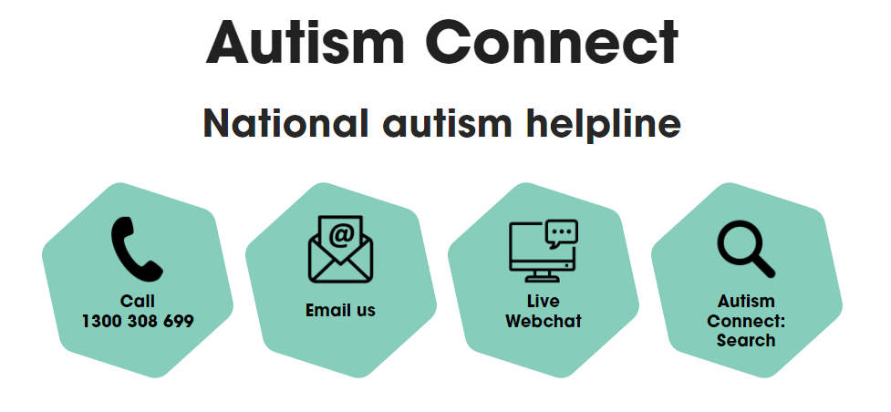


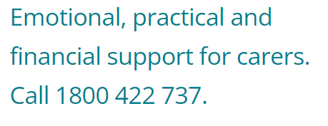

Other practical supports
Notes:
SUGGESTED TIME: 1 min · 3:09 - 3:10
PURPOSE
Introduce the support pathways included in the workshop.
WHAT TO DO
1. Briefly introduce the Positive Partnerships support options and other supports on the slide.
2. Point participants to Participant Guide p. 30 for resources.
KEY MESSAGES
• Introduce the Positive Partnerships support options included with the workshop.
KEEP IN MIND
• Check phone numbers and services are current before delivery.

Slide 19
Bridge to the next family conversation
Prepare for one purposeful conversation.
What needs to be understood?
What question will open the conversation?
How will the student's voice be included?
What can be decided together?
How and when will the school follow up?
Keep these notes for your conversation plan in Session 6.
Notes:
SUGGESTED TIME: 5 min · 3:10 - 3:15 · Participant Guide p.25 - Bridge to the next family conversation
PURPOSE
Identify the question and shared purpose participants will take into the Session 6 conversation plan.
WHAT TO DO
1. Ask participants to return to the students they have in mind and their day-one setup.
2. Invite them to work through the prompts on the slide privately.
3. Suggest they use the opening question they wrote in The first two minutes (p. 24).
4. Keep the focus on preparation rather than scripting what the family should say.
5. Ask participants to carry one process change from the power reflection into the plan, and to note who could help them prepare.
6. Preview the closing session on belonging, capacity, joy and practical next steps.
YOU MIGHT SAY
Keep these notes for your conversation plan in Session 6.
KEY MESSAGES
• Prepare for one purposeful conversation.
ACTIVITY: Private bridge reflection · on your own · 4 minutes
Prompt: Prepare for one purposeful conversation.
1. What needs to be understood?
2. What question will open the conversation?
3. How will the student's voice be included?
4. What can be decided together?
5. How and when will the school follow up?
Close: Keep these notes available for the family-conversation plan in Session 6.
THREAD
Connects to the Session 4 asking list, The first two minutes (p. 24) and the conversation plan in Session 6 (Participant Guide p. 28).

